Slide 1

Stock Price Analysis and Prediction using PySpark and Machine Learning

Slide 2
Team
Nishanth Raju Saraswathi
Manoj Kumar Kandimalla
Sai Supreeth Papishetty
Siva Bhargavi Pesarlanka

Slide 3
Agenda
Introduction
Tools and Technologies
Goals
Results on PySpark
Conclusion

Slide 4
Introduction
The main aim of the project is to develop models using PySpark to predict stock prices based on historical data.
Preprocessing the dataset, training different machine learning algorithms, assessing model performance, and deploying the top-performing model for prediction are all part of the process.
The project offers a structured approach to analyzing stock market data, building predictive models.
It also provides actionable insights for investment strategies.

Slide 5

Tools & Technologies
Python
PySpark
Apache Spark
Pandas
Matplotlib
Jupyter Notebook

Slide 6

Goals
Goal 1: Investigate the historical trends of stock prices
Goal 2: Investigate the historical trends of trading volumes
Goal 3: Develop predictive models to forecast future stock prices
Goal 4: Develop predictive models to forecast future trading volumes

Slide 7
Goals
Goal 5: Identify patterns and correlations in the data for stock price prediction
Goal 6: Identify patterns and correlations in the data for trading volume prediction
Goal 7: Evaluate the performance of different machine learning algorithms for stock price prediction
Goal 8: Evaluate the performance of different machine learning algorithms for trading volume prediction

Slide 8
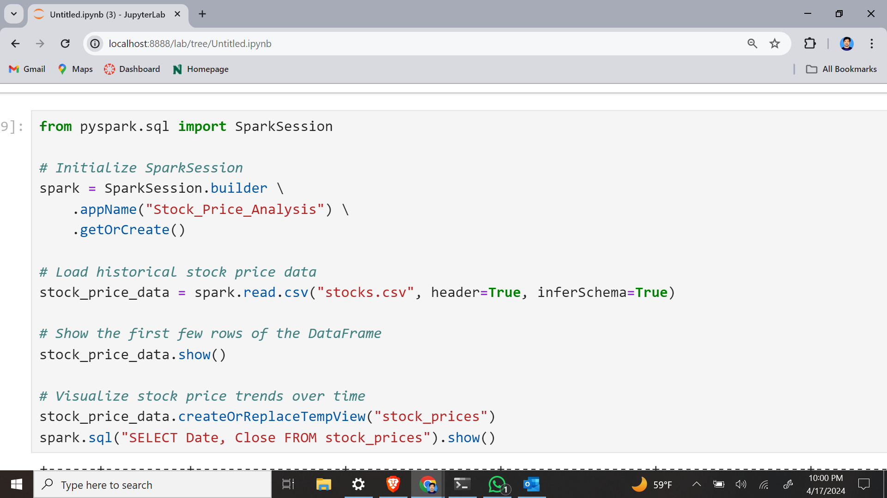
Results
Goal 1: Investigate the historical trends of stock prices

Slide 9
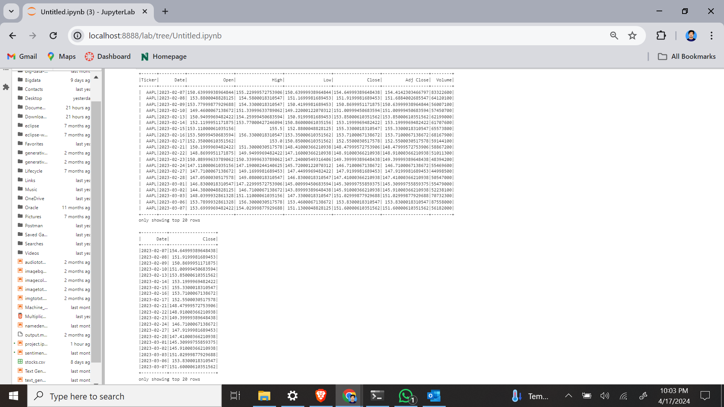
Here we are analyzing the historical data by plotting the stock prices over time by using statistical techniques like moving averages to identify trends and fluctuations.

Slide 10
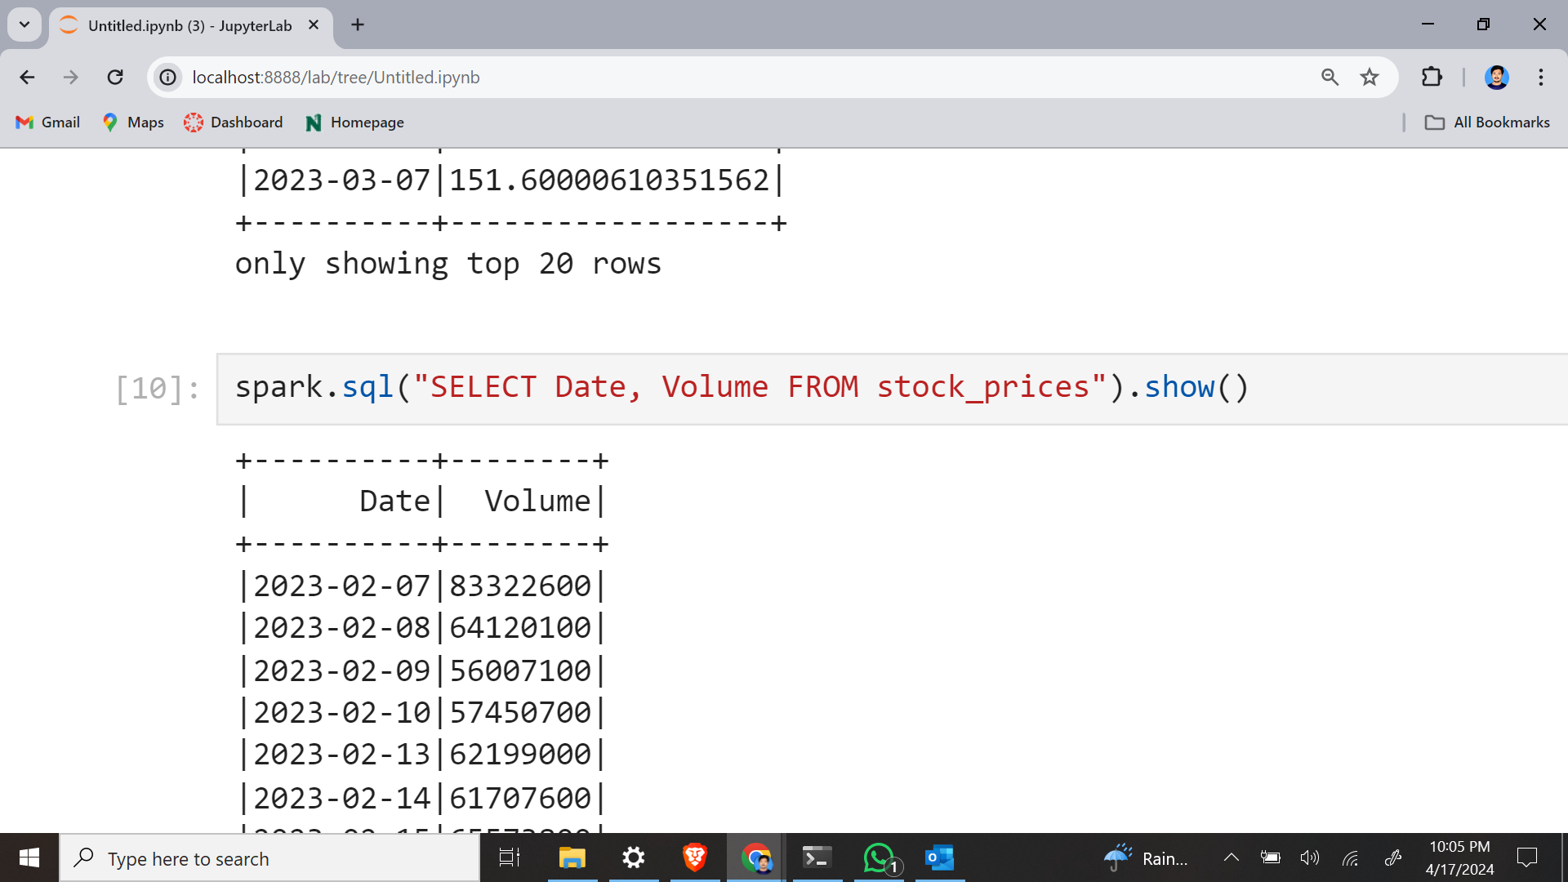
Goal 2: Investigate the historical trends of trading volumes

Slide 11
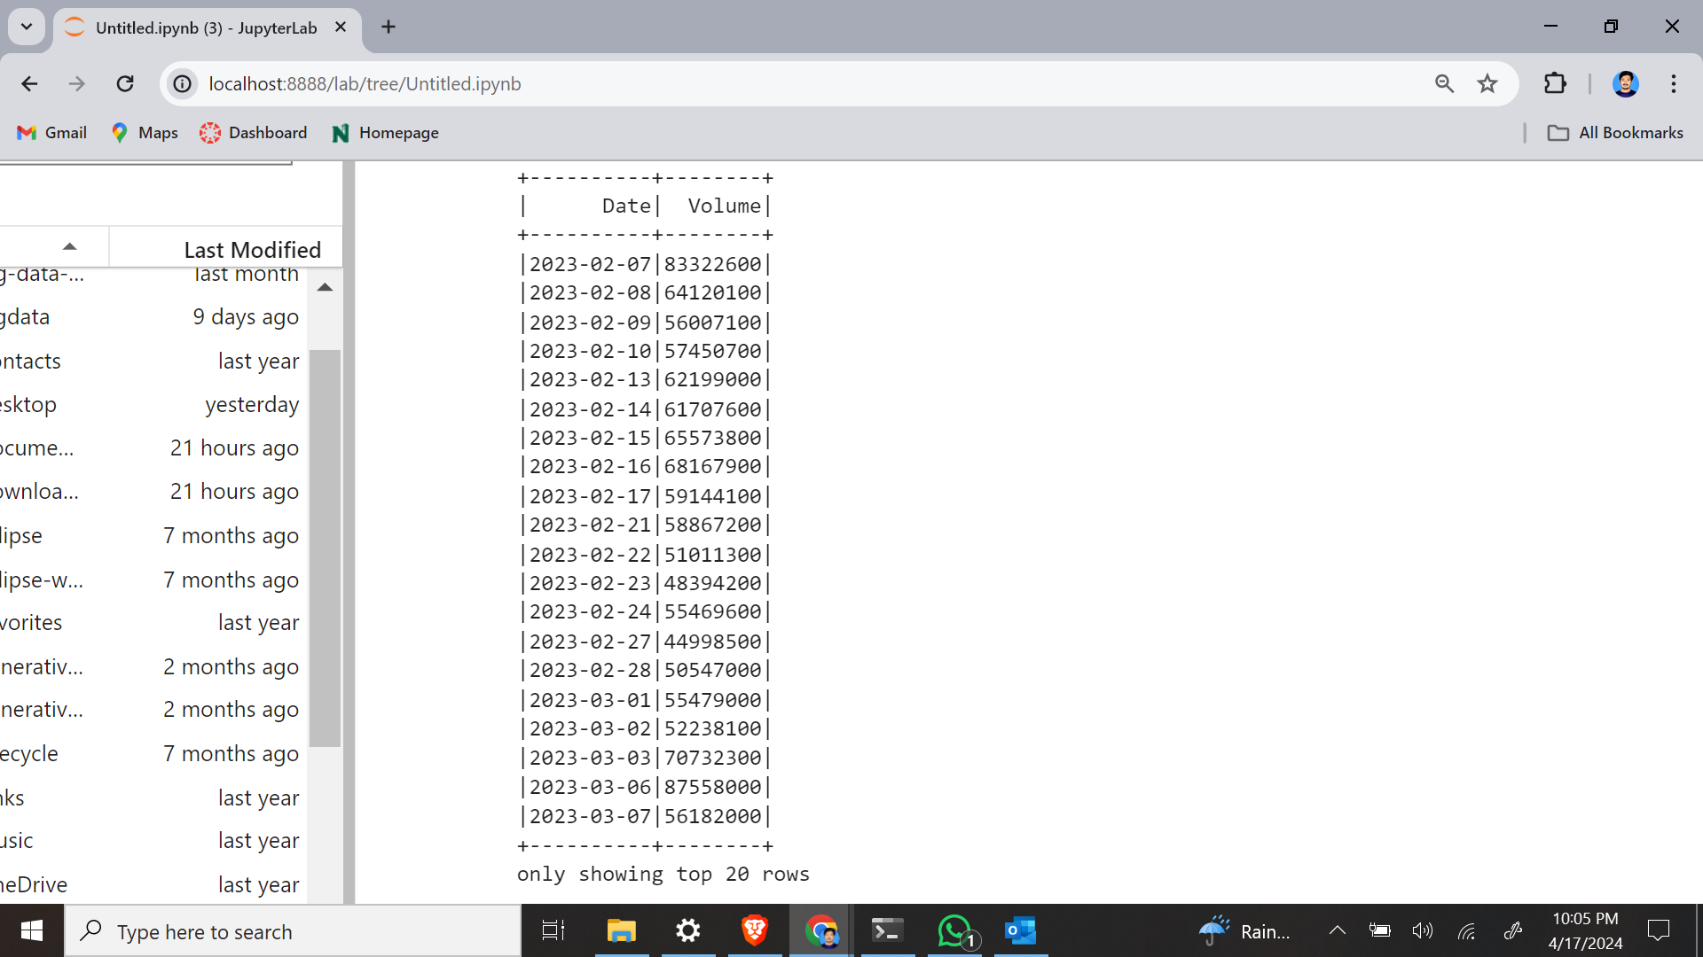
Here we are analyzing the historical data by plotting the trading volumes over time by using statistical techniques like moving averages to identify trends and fluctuations.

Slide 12
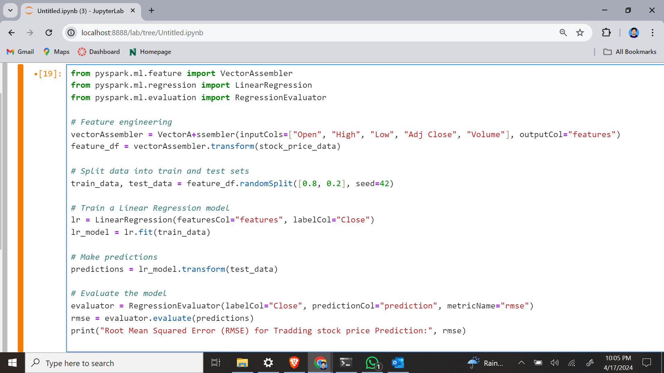
Goal 3: Develop predictive models to forecast future stock prices

Slide 13
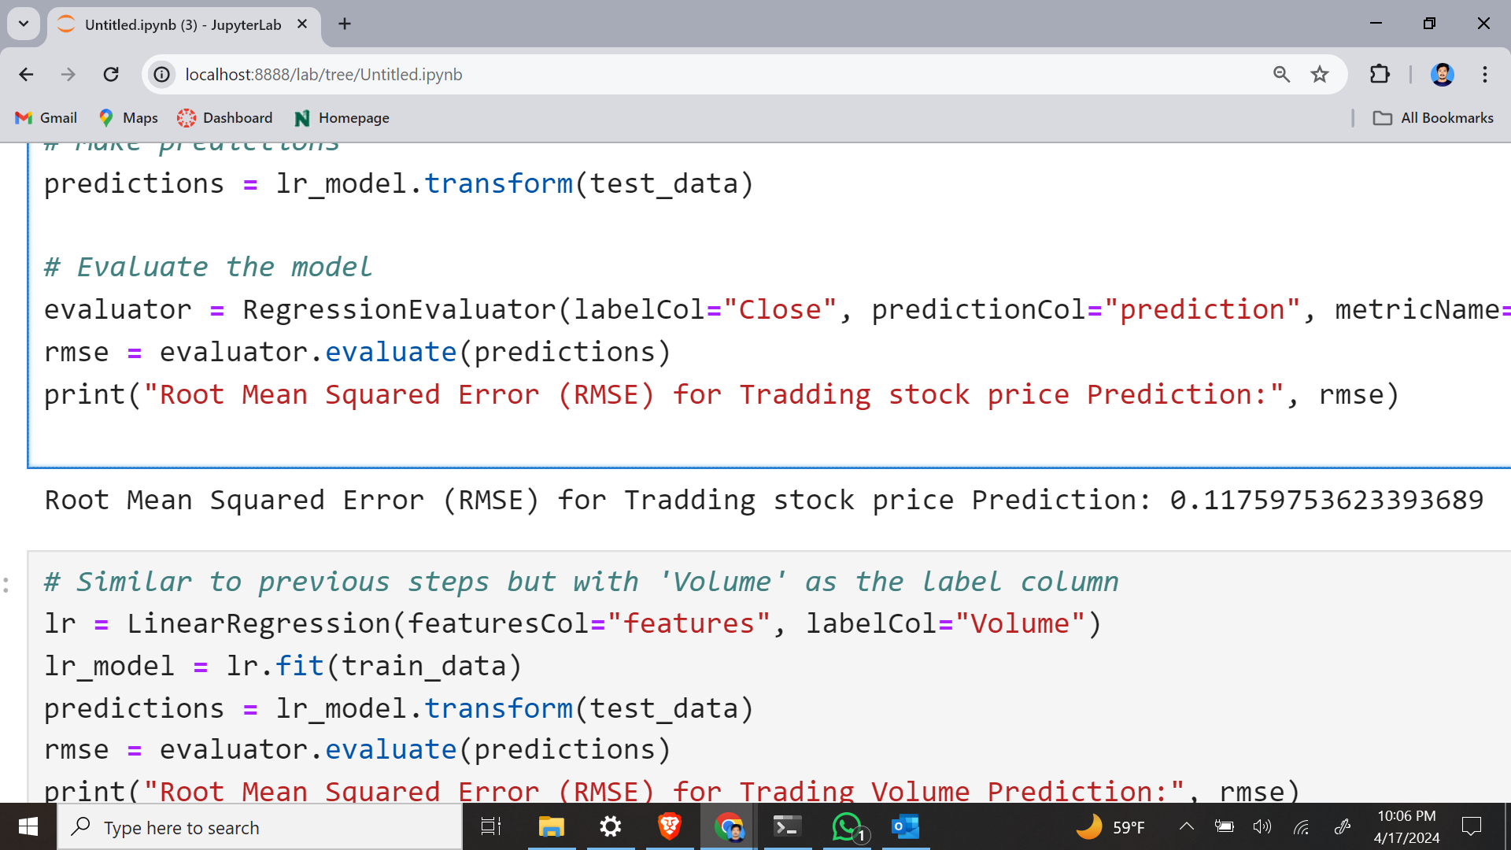
Validating predictive models that can effectively forecast future stock prices based on historical data.

Slide 14
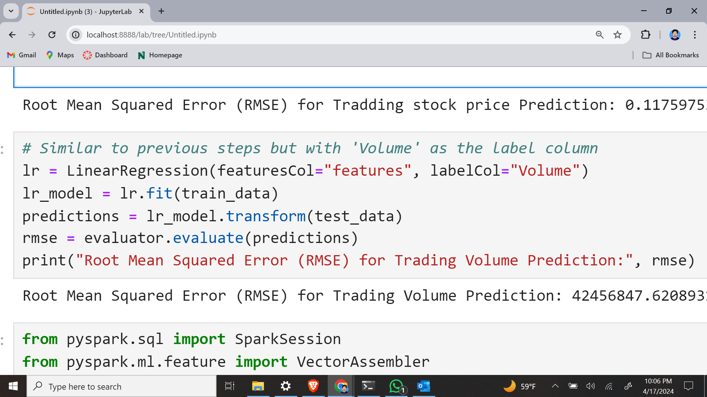
Goal 4: Develop predictive models to forecast future trading volumes

Slide 15
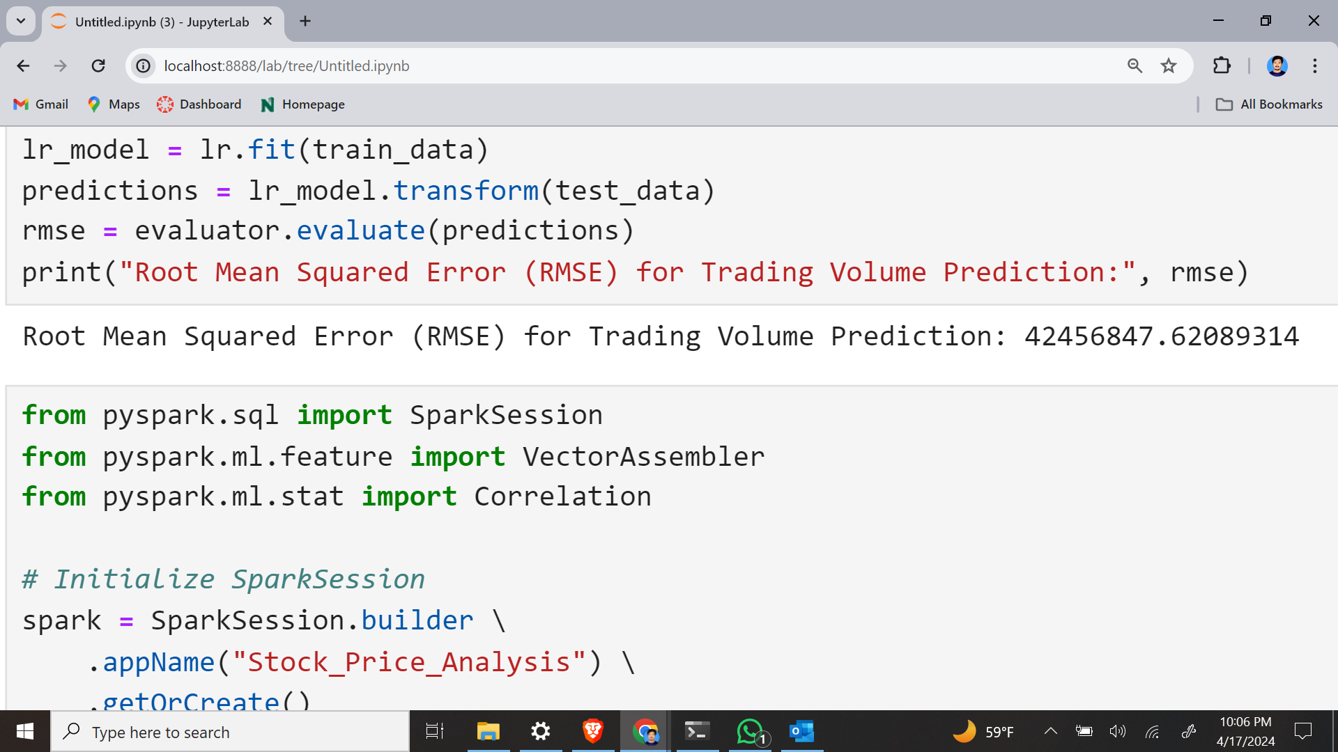
Developing and validating predictive models capable of accurately forecasting future trading volumes based on historical data.

Slide 16
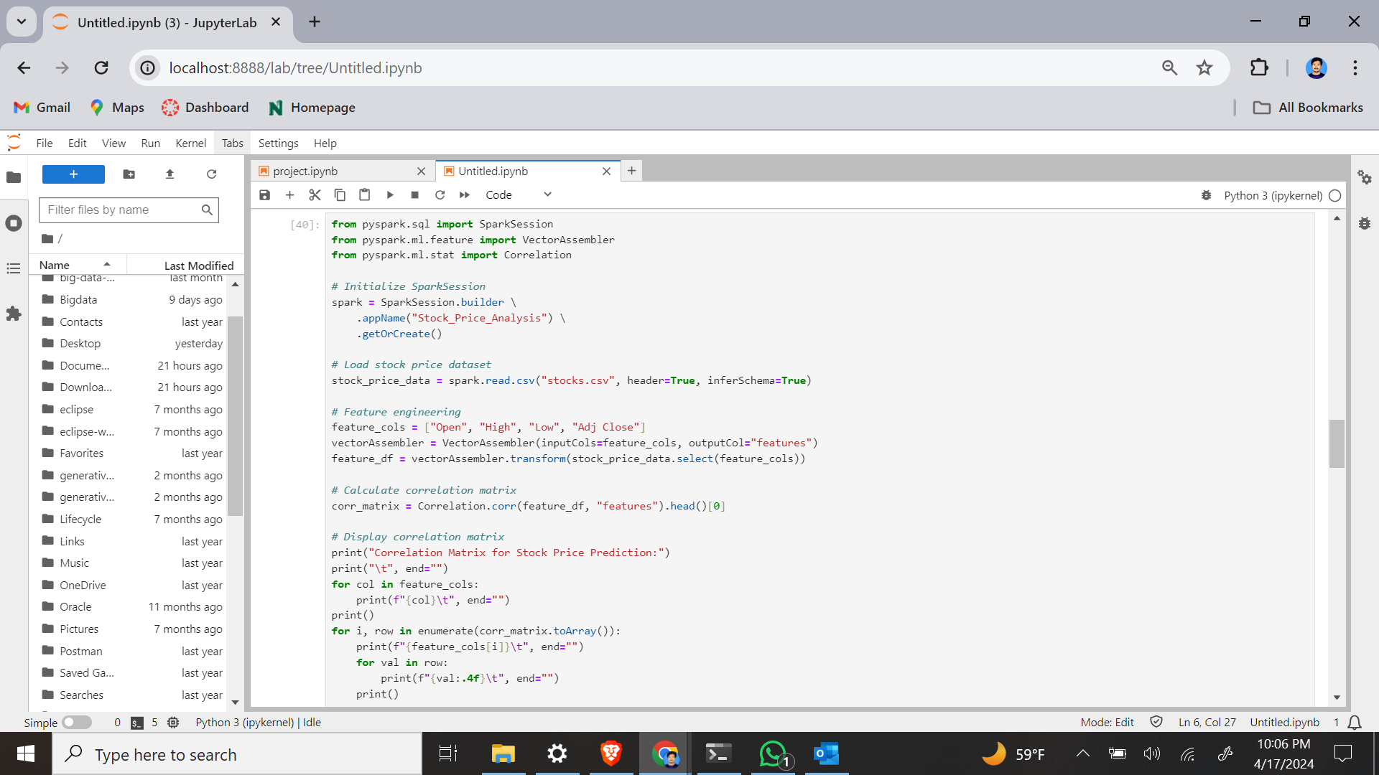
Goal 5: Identify patterns and correlations in the data for stock price prediction

Slide 17
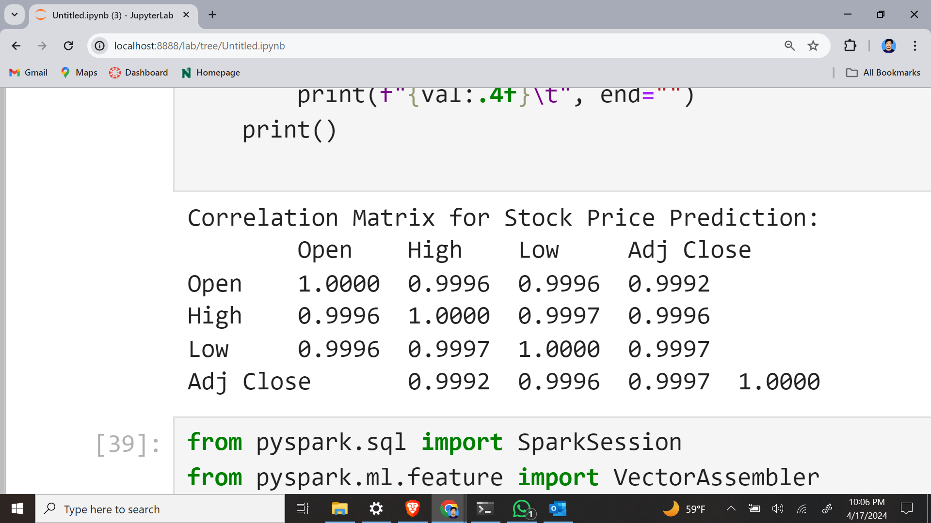
Exposing meaningful insights into the factors affecting stock prices and their relationships.

Slide 18
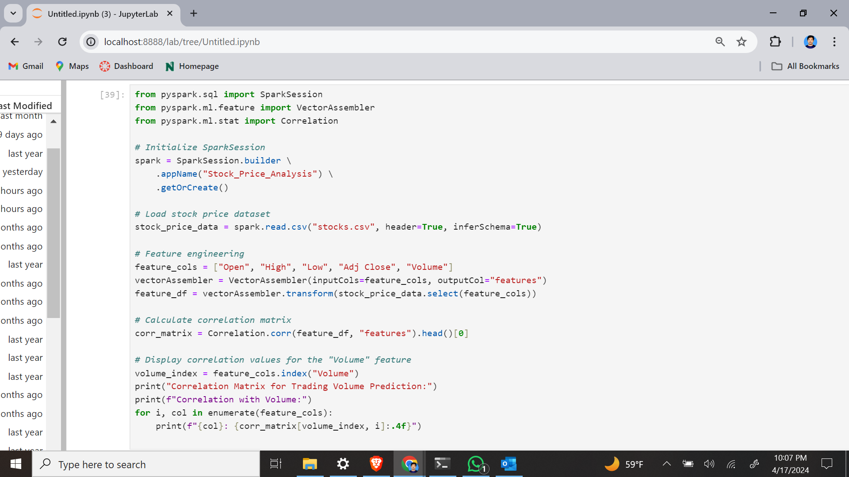
Goal 6: Identify patterns and correlations in the data for trading volume prediction

Slide 19
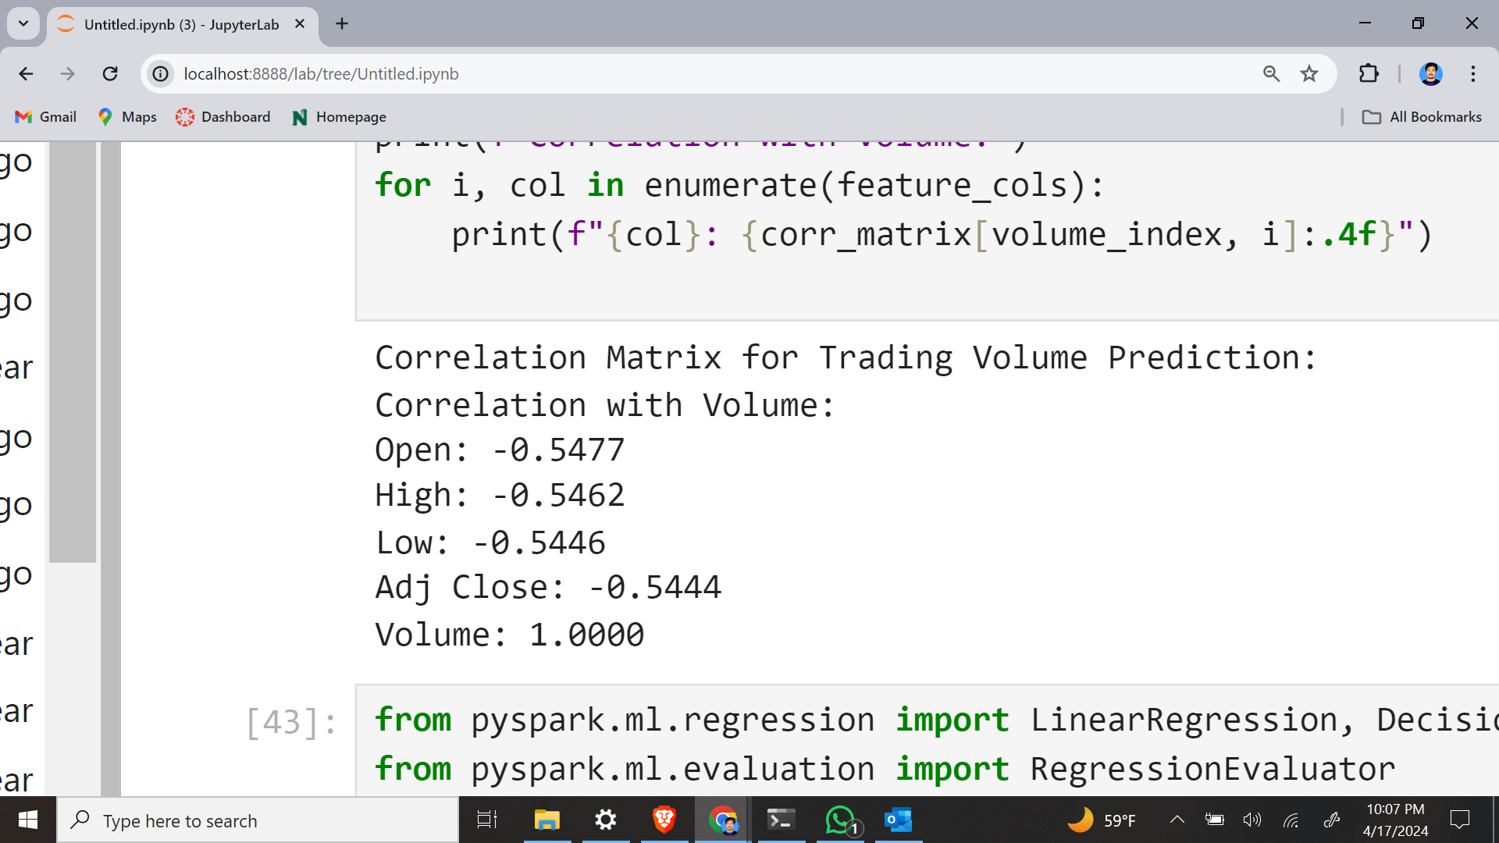
Exposing meaningful insights into the factors affecting trading volumes and their relationships.

Slide 20
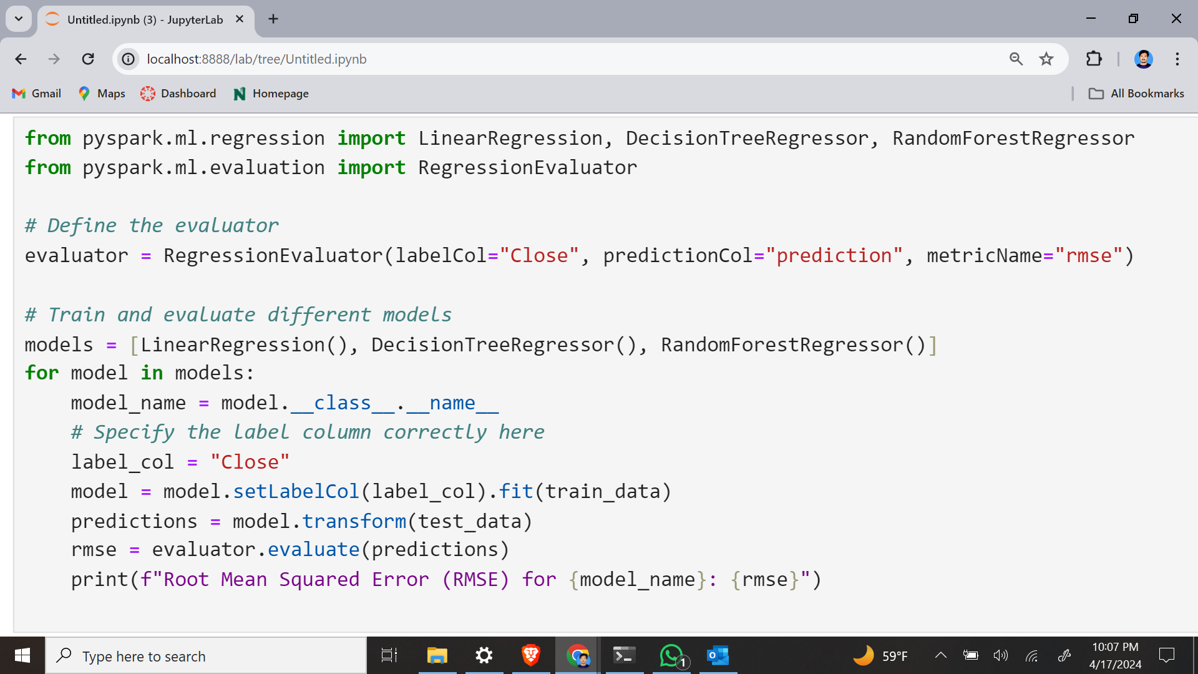
Goal 7: Evaluate the performance of different machine learning algorithms for stock price prediction

Slide 21
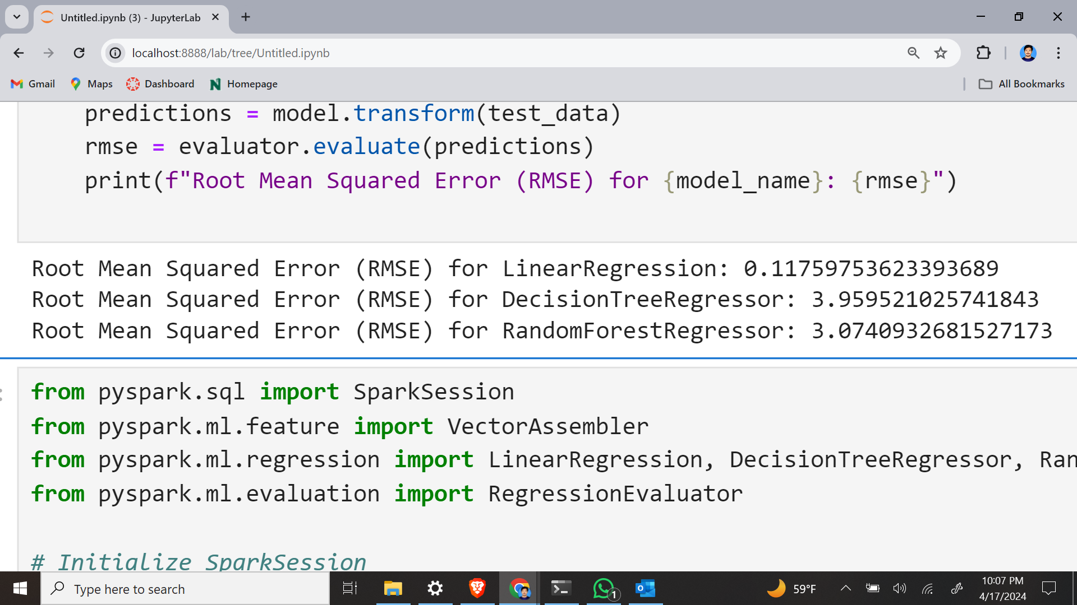
Assessing the effectiveness of various machine learning algorithms in predicting stock prices and identify the best-performing model for accurate and reliable predictions.

Slide 22
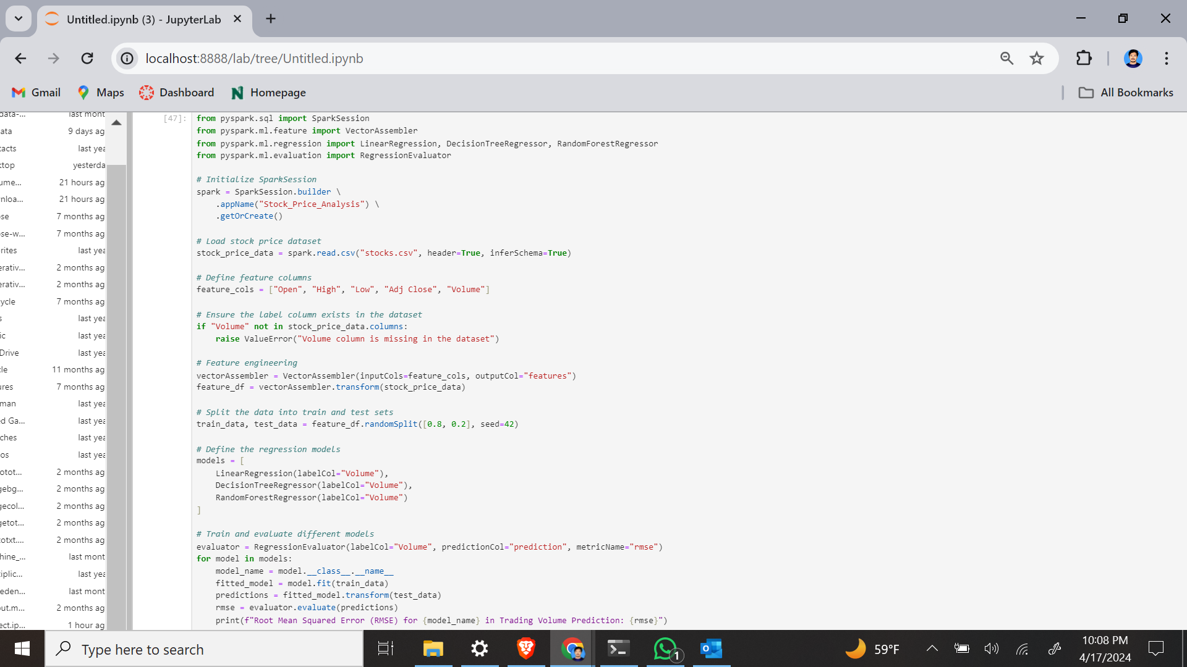
Goal 8: Evaluate the performance of different machine learning algorithms for trading volume prediction

Slide 23
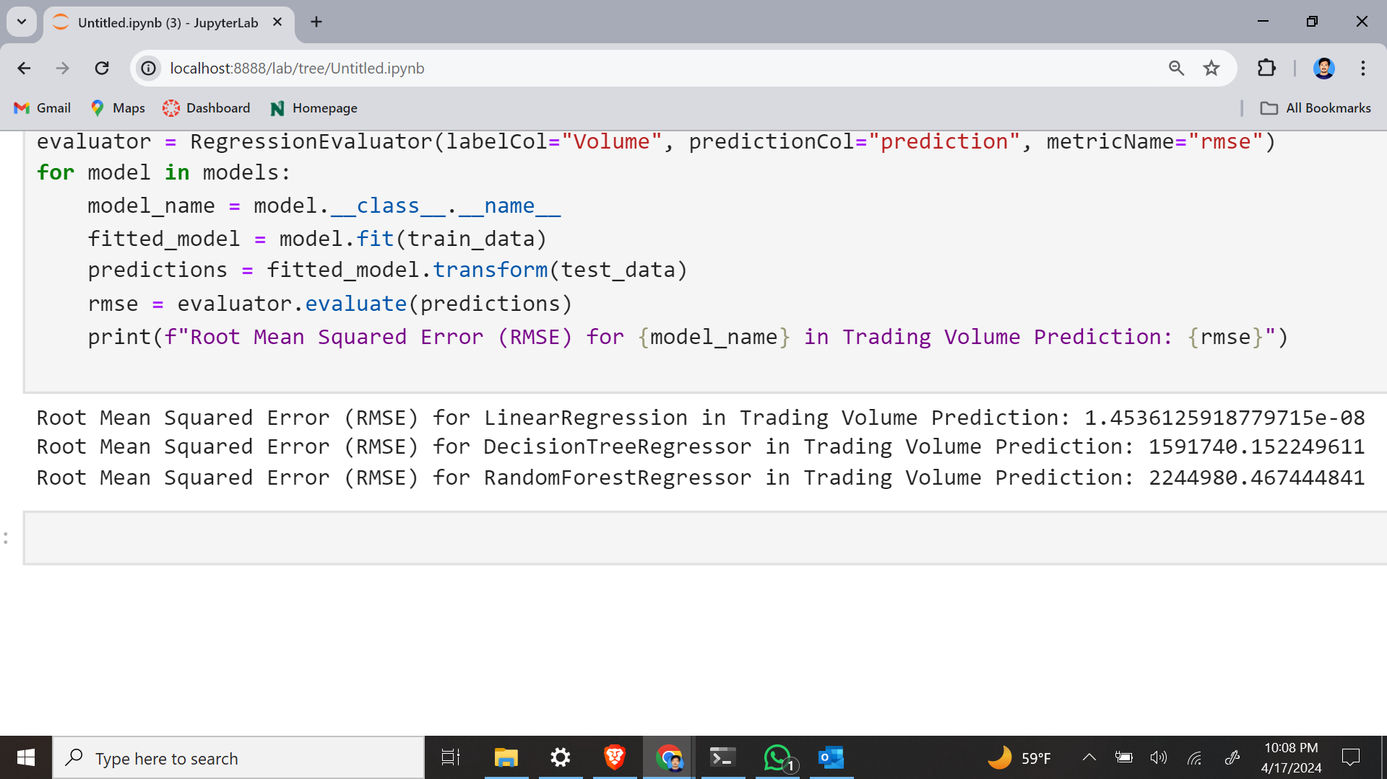
Assessing the effectiveness of various machine learning algorithms in predicting trading volumes and identify the best-performing model for accurate and reliable predictions.

Slide 24
Conclusion
The project demonstrates how pySpark can be used effectively to analyze financial data and create stock price prediction models.
Analyzing the historical data by plotting the stock prices and trading volumes over time.
Evaluation and validation of models, employing metrics like Root Mean Squared Error (RMSE) and cross-validation techniques, ensure their reliability and effectiveness in real-world scenarios.
Identifying patterns and correlations in the data for stock price and trading volume prediction.
Demonstrating promising performance in forecasting future stock prices and trading volumes.
Evaluating the performance of different machine learning algorithms for stock price and trading volume prediction.

Slide 25

Thank you

